Slide 1
Store Item Demand Forecasting Challenge
Team 15: Lena Mueller, Jhanvi Patel, Zach Washburn, David Fernandez

Slide 2
Agenda:
Overview of the competition
Dataset and Key Features
Review of other Notebooks in the competition
Team 15’s R Script

Slide 3
Overview and Objective of the Competition:
For this competition we were provided with 5 years worth of store-item sales data
We were given 50 items at 10 different stores to forecast
How do we best deal with seasonality, should we model the stores together or separately?

Slide 4
Where does the Data Set come from and what are the Key Features?
Data set is provided by Kaggle, does not directly specify the source
The key features of the data set include:
Dates
Stores (10)
Items (50)
Sales per store and item

Slide 5
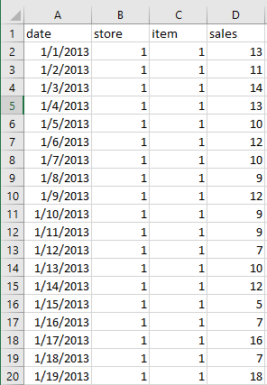
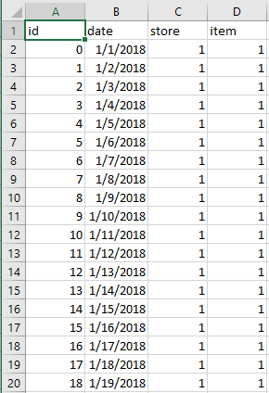
train.csv
test.csv
Notes:
Talk about problems with the dataset
Date column was not formatted correctly
# of rows

Slide 6
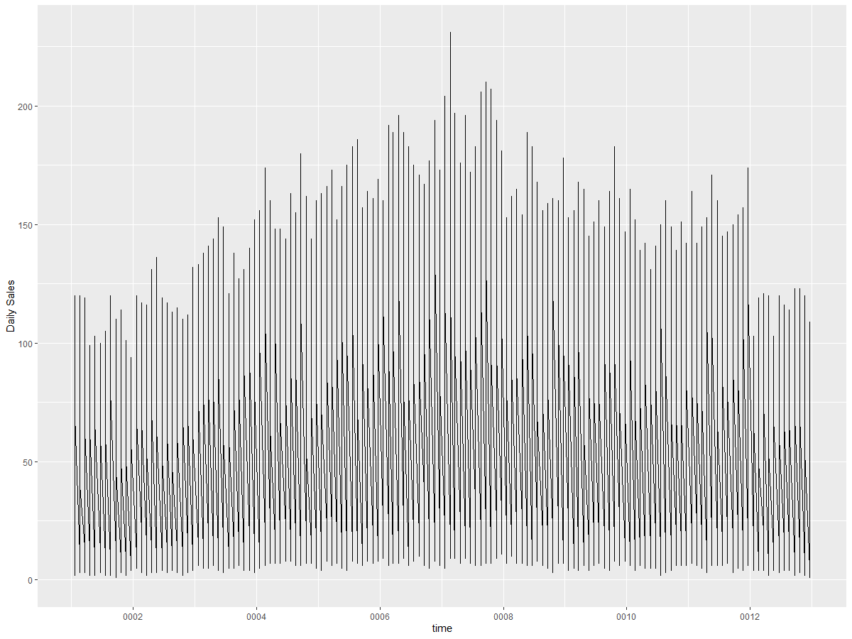
Critique of Notebook “Basic Time Series Forecasting”
This submission was mostly script based
This Notebook made good use of basic functions to create time series forecasting
ggplot, arima, acf and pacf plots
The plot, however, was not very interpretable
Plot looks like white noise
Not a great display of seasonality
Did not explore seasonality beyond the year
Their prediction did not change based on their model
Used prophet for forecasting
Notes:
https://www.kaggle.com/code/indranilbhattacharya/basic-time-series-forecasting

Slide 7
Basic Time Series Chart

Slide 8
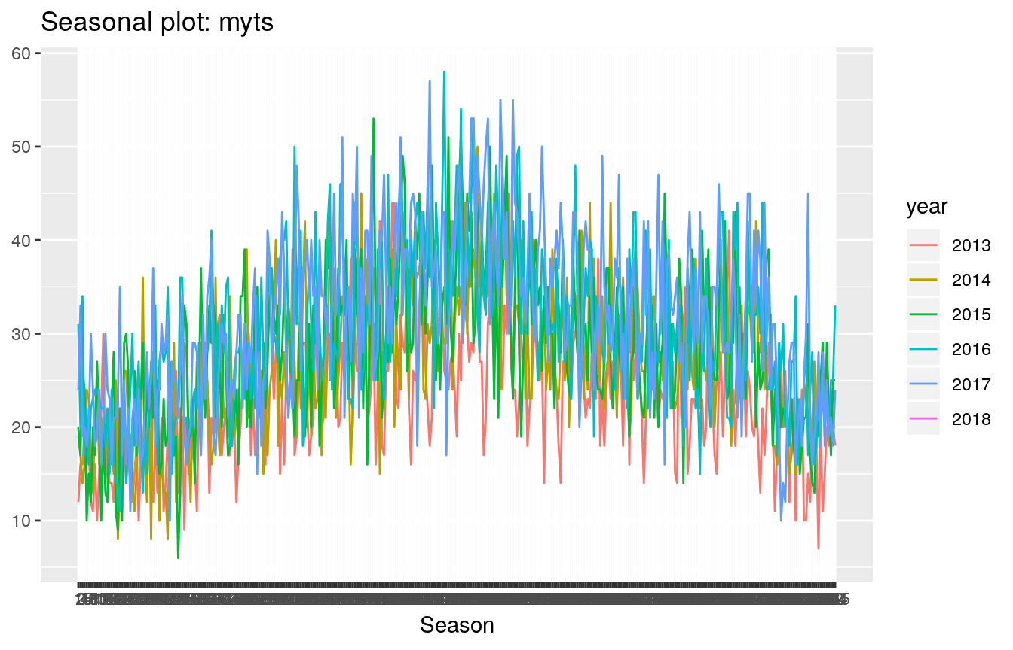
Critique of Notebook “Introduction to Forecasting”
Overview: Based on the prompt of the Store Item Demand Competition this Notebook scored very highly. Report was in-depth with great use of time-series graphics
Seasonal plots looked very crowded, hard to distinguish between years in exploratory data
Notes:
https://www.kaggle.com/code/moizzz/introduction-to-forecasting

Slide 9
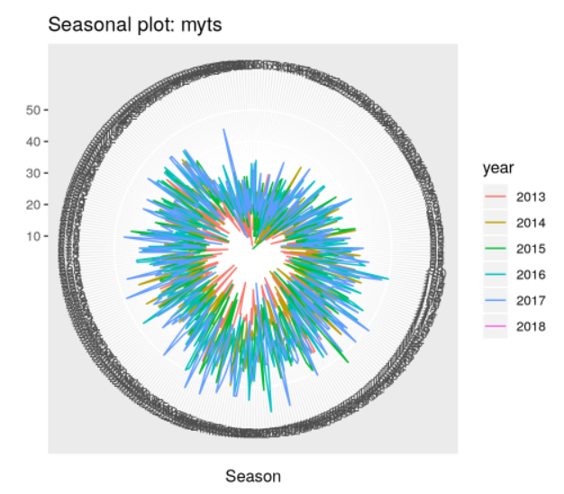

Slide 10

Critique of Select Notebook “Introduction to Forecasting”
3. Only one type of seasonality is present, would like to see the time series long enough so that the longer seasonal periods are apparent.
4. Based on the prompt, this notebook only ran a sample for the train data instead of analyzing the data based on the group of stores or the entire dataset
Granted, running the entire dataset takes a large amount of computing power and time.
5. Would like to zoom into the holiday effects in seasonality.
Notes:
https://www.kaggle.com/code/moizzz/introduction-to-forecasting

Slide 11
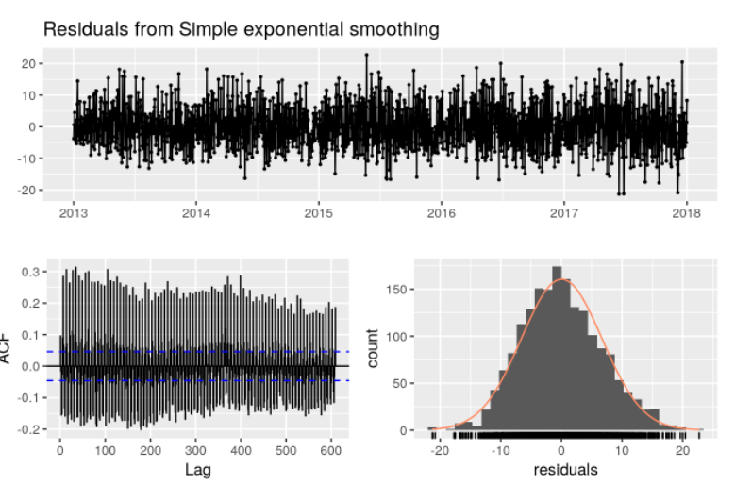
Critique of Notebook “Introduction to Forecasting”
6. Hard to infer seasonality other than by year (day, week, month)
7. Models had very little white noise since p value < 0.05 and ACF had lines above the threshold range
Overall this Notebook only predicts one time series at a time and needs more parameters to be specified to do a complete TS forecast
Notes:
https://www.kaggle.com/code/moizzz/introduction-to-forecasting

Slide 12
Team 15’s Conclusion:
To forecast the Store Data, we used simple methods of forecasting
Naive methods, seasonal decomposition, simple exponential smoothing, Holt method
ARIMA performs all the work for you behind the scenes so we decided to forecast using beginner forecasting methods that use the basic snapshot of historical data to make a prediction
Ultimately, this did not give us a great Root Mean Squared Error (RMSE) or Mean Absolute Error (MAE) but was one of the easiest methods for forecasting data.
Important to mention that the Kaggle competition topic of Time Series was not heavily covered in our ML coursework.
Based on what we learned in Stochastic Modelling we made a single prediction whereas for the Kaggle competition we had to predict sales based on multiple stores and items
Notes:
To answer the Kaggle competition prompt we decided to give the option to forecast for one store or multiple stores. We believe forecasting for one store is best as there can be variation of sales/trends between the physical stores, therefore, we are able to focus on how individual items perform at specific stores.

